Slide 1

FYP presentation
School of Engineering
Supervisor: Mr. Leong Kuan Jeet
By: Muhammad Hanafi Bin Mokhri (155893X)
Module: Electronics, Computer & Communications Engineering

Slide 2
Table of Contents
Project objective
Project Hardware & Software
Task Completed
Problems encountered
Gantt chart
Conclusion

Slide 3
Project objective
To develop a smart locking device using your mobile phone and Arduino.

Slide 4
Project overview
A smart door that can make doors work smarter by allowing the user to lock, unlock, close and open doors without being at the door.

Slide 5
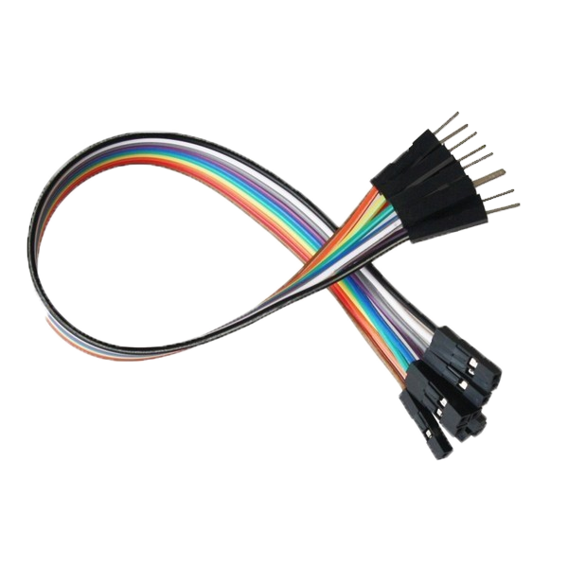
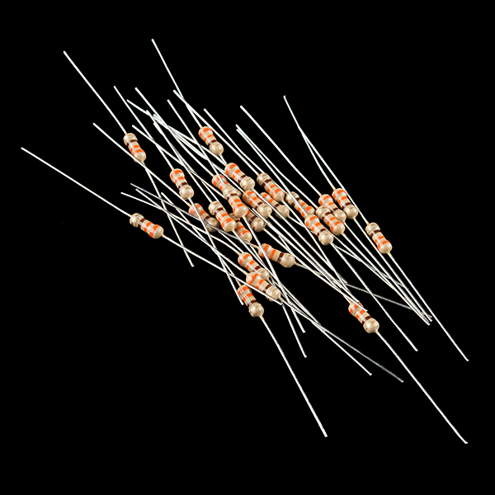
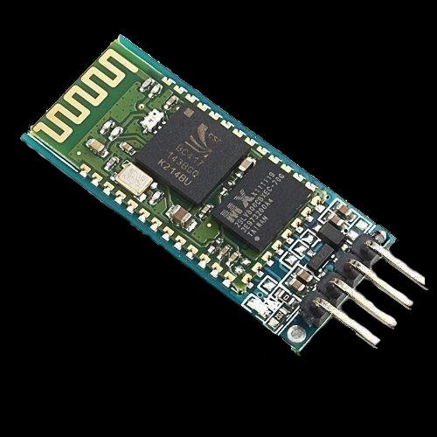
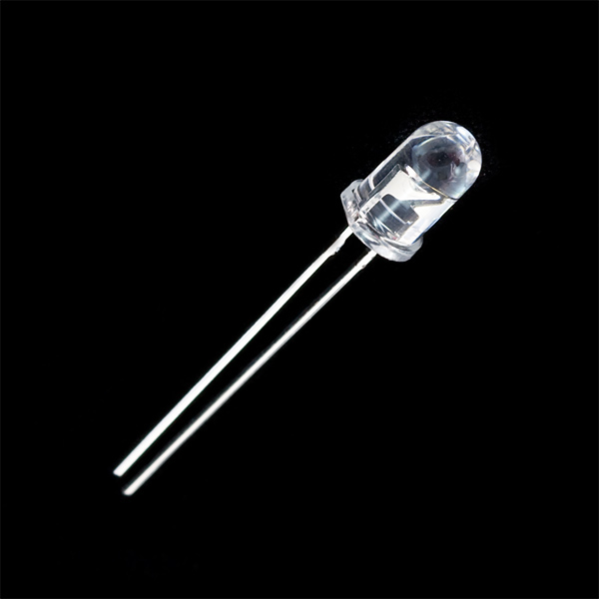
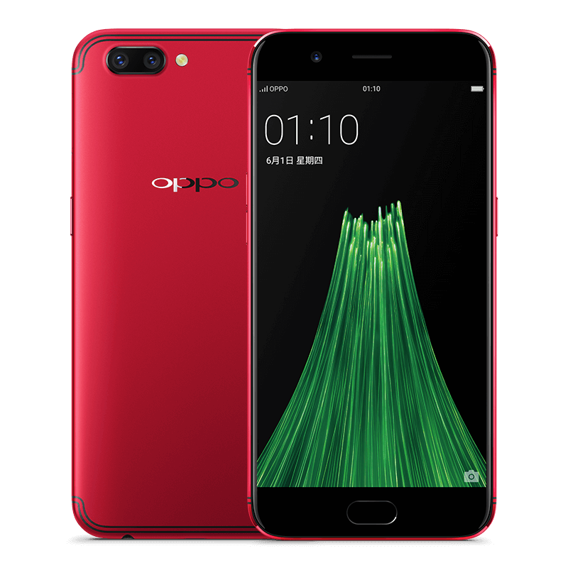
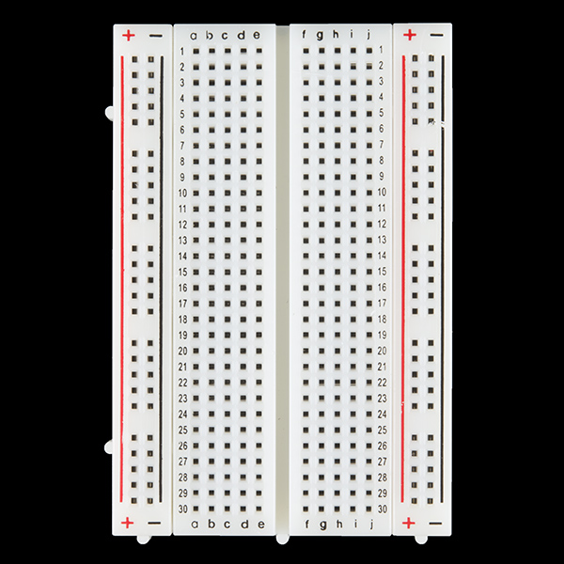
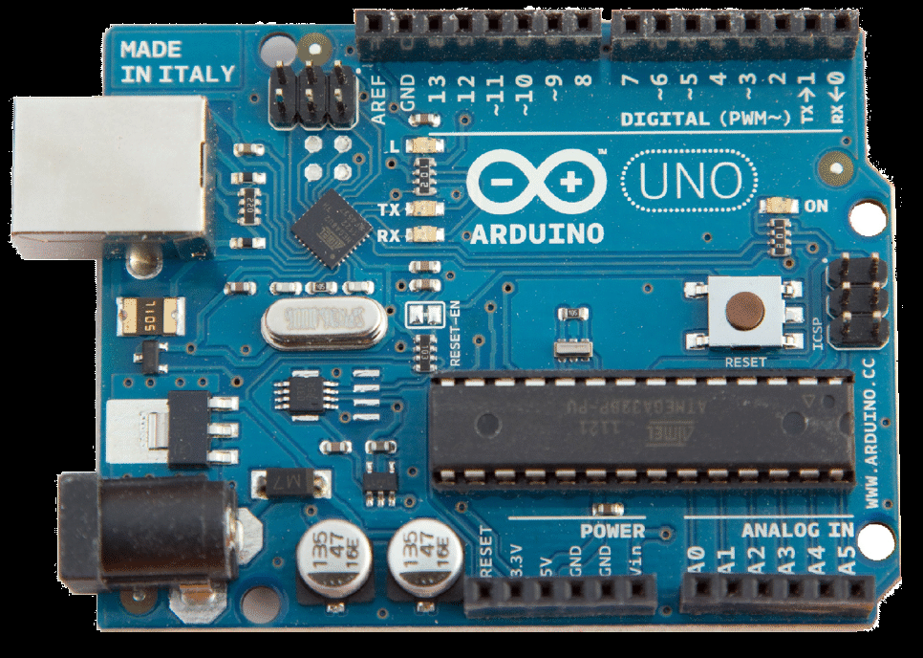
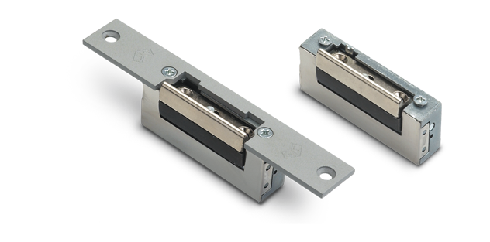
Hardware
Arduino UNO board x 1
Wires
Breadboard
LED lights
Door latch
Assortment of resistors
Bluetooth module
(HC-06 and ARF7044A)
Smartphone
Relay

Slide 6
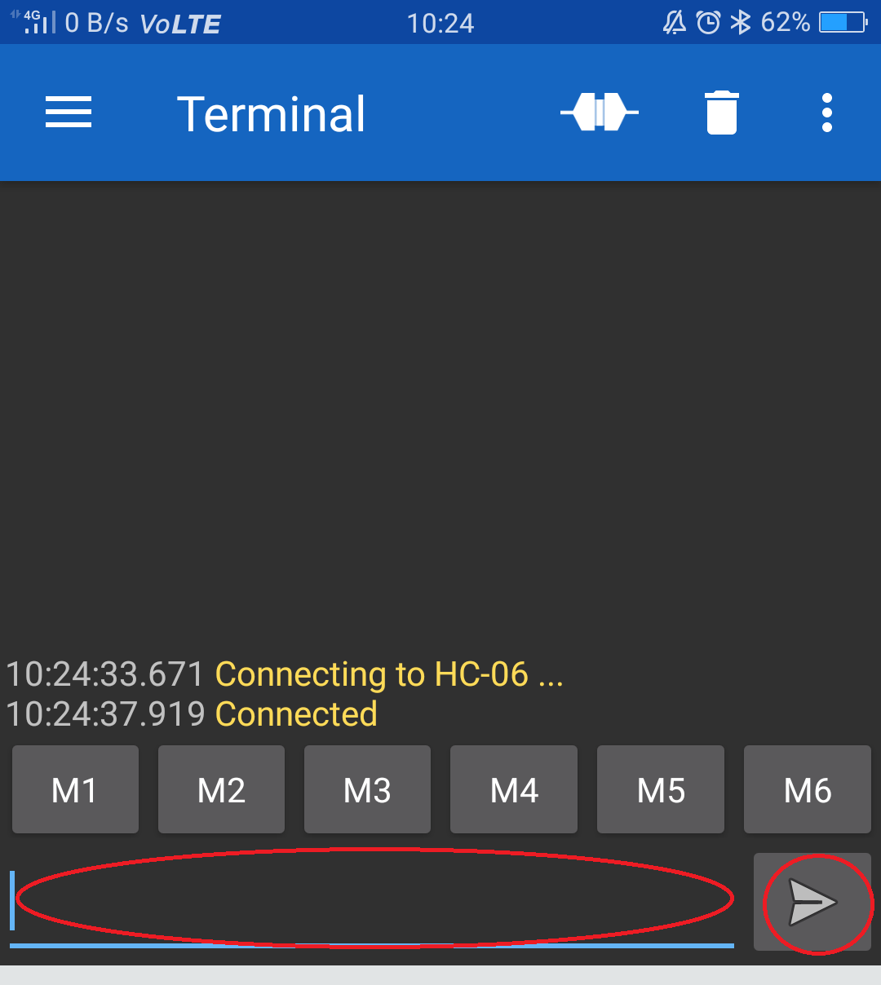
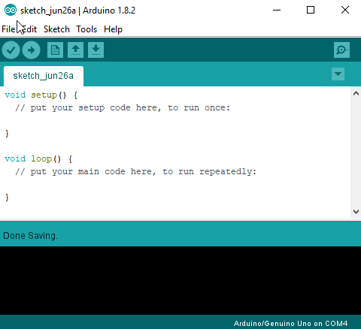
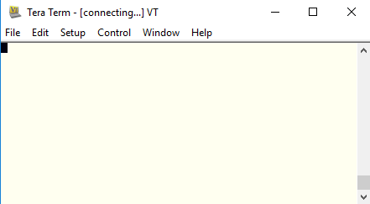
Software
Arduino IDE
Tera Term
Serial Bluetooth Terminal
MIT App inventor

Slide 7
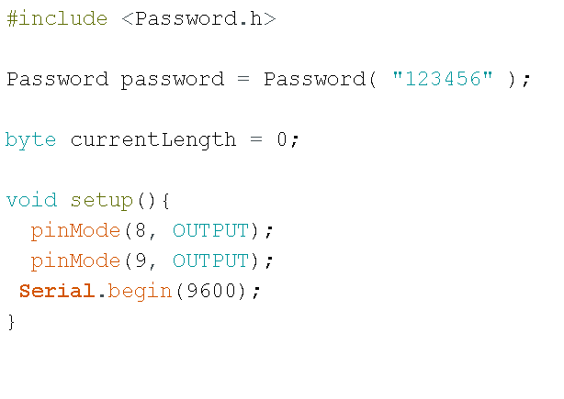
Code part 1

Slide 8
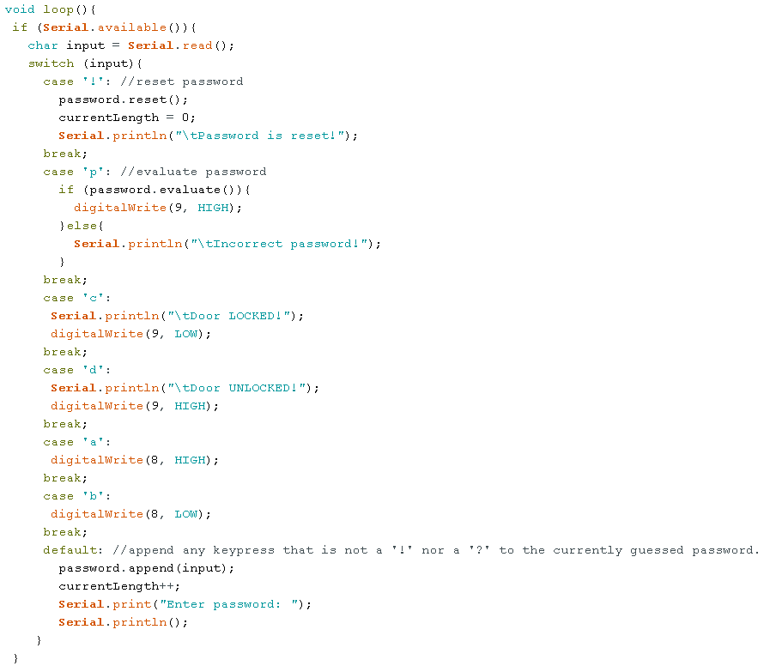
Code part 2

Slide 9
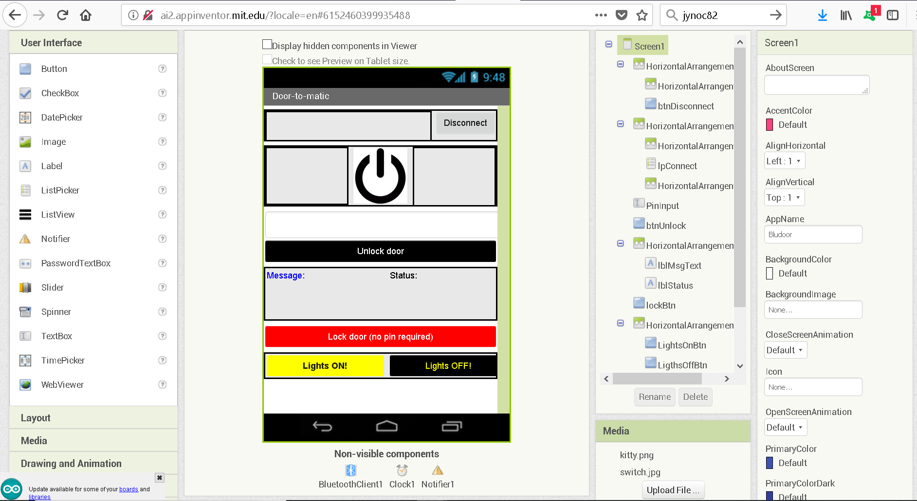
App design

Slide 10
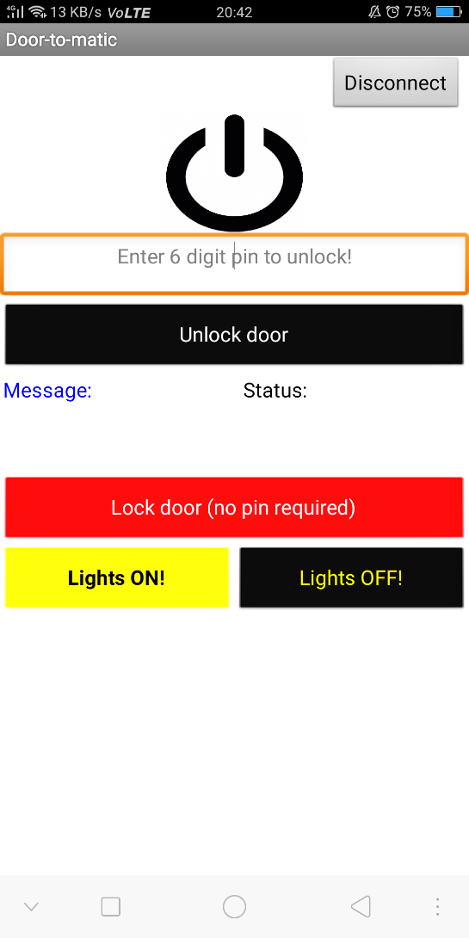

Slide 11
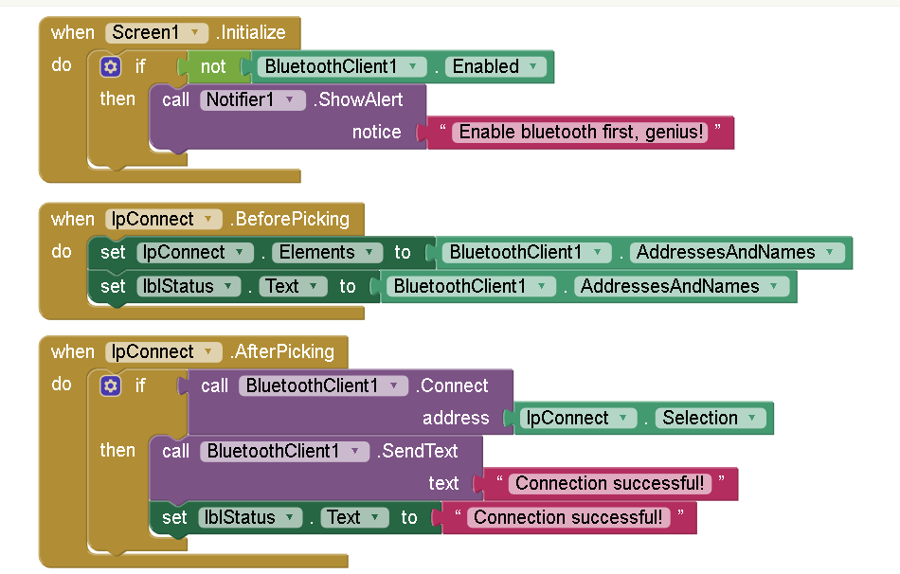
App code part 1

Slide 12
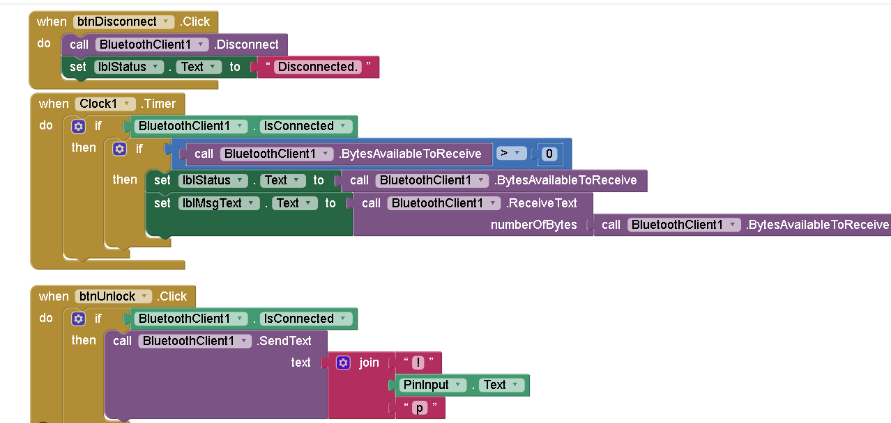
App code part 2

Slide 13
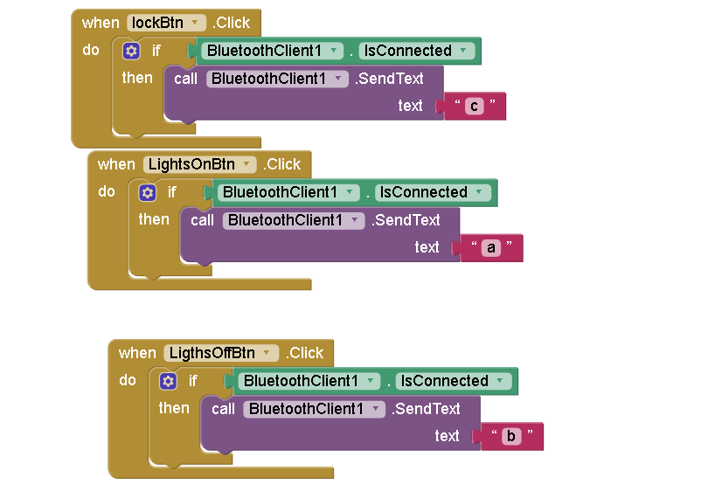
App code part 3

Slide 14
Project
Week 1
A lot of research was done during week 1, mainly re-learning arduino and how it works in general as it’s been a long time since I programmed an arduino board.
Week 2
After week 1 was over and a “foundation” was attained, I tried some simple codes to test the waters. I tried to communicate between arduino and bluetooth and made a simple code which allowed the phone to turn on and turn off the LED by sending a certain character, in my case it was either an ‘a’ to turn on the LED or ‘b’ to turn off the LED.

Slide 15
Project
Week 3
A lot of research was done during week 1, mainly re-learning arduino and how it works in general as it’s been a long time since I programmed an arduino board.
Week 4
After week 1 was over and a “foundation” was attained, I tried some simple codes to test the waters. Once I got the gist of it, I tried to communicate between arduino and bluetooth and it worked.

Slide 16
Tasks completed
Research on Arduino and Bluetooth in general
Testing simple Arduino codes
Making a simple bluetooth-controlled door latch and led with relay.
Making an app for android using MIT App Inventor.

Slide 17
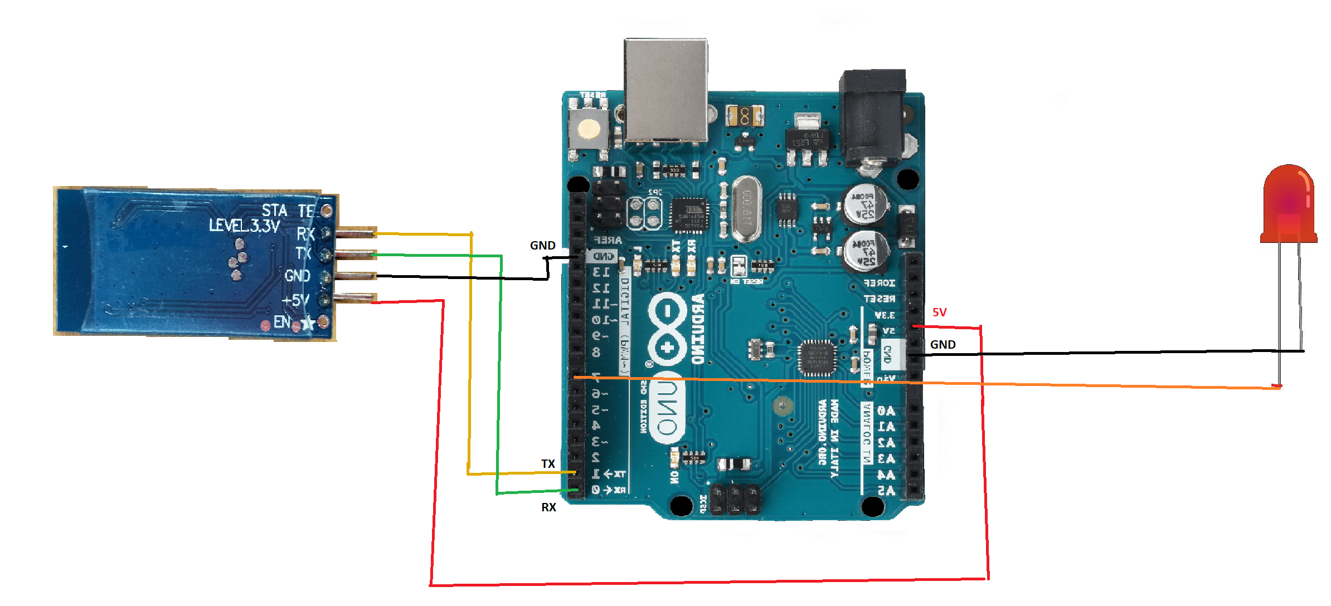
Bluetooth module schematic

Slide 18
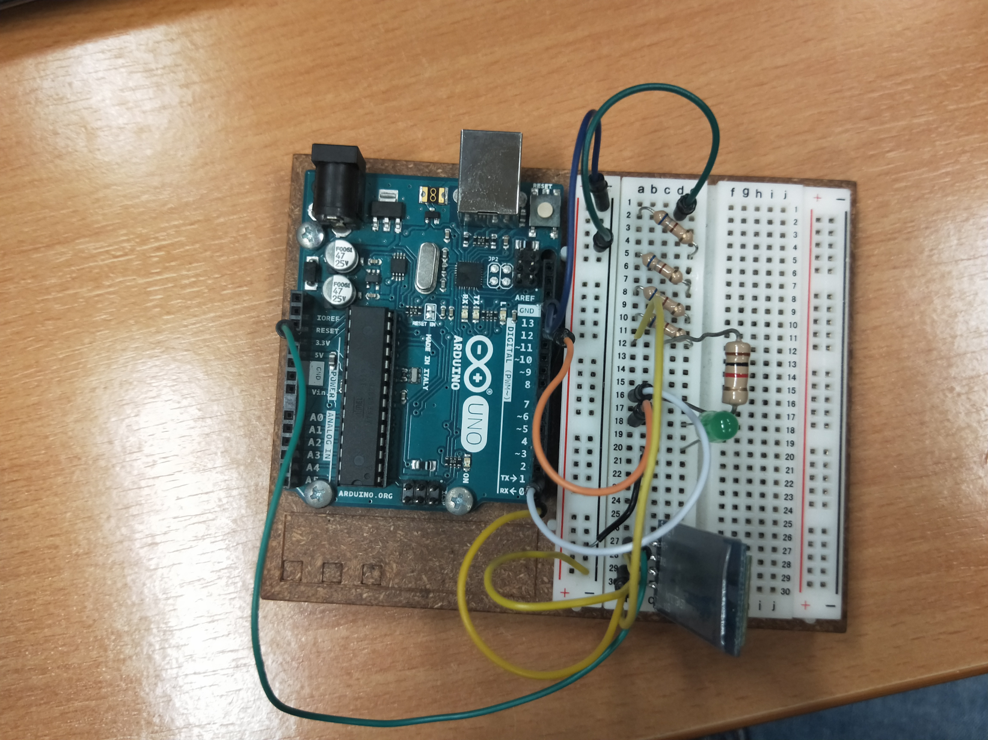
Tasks completed (continued)

Slide 19
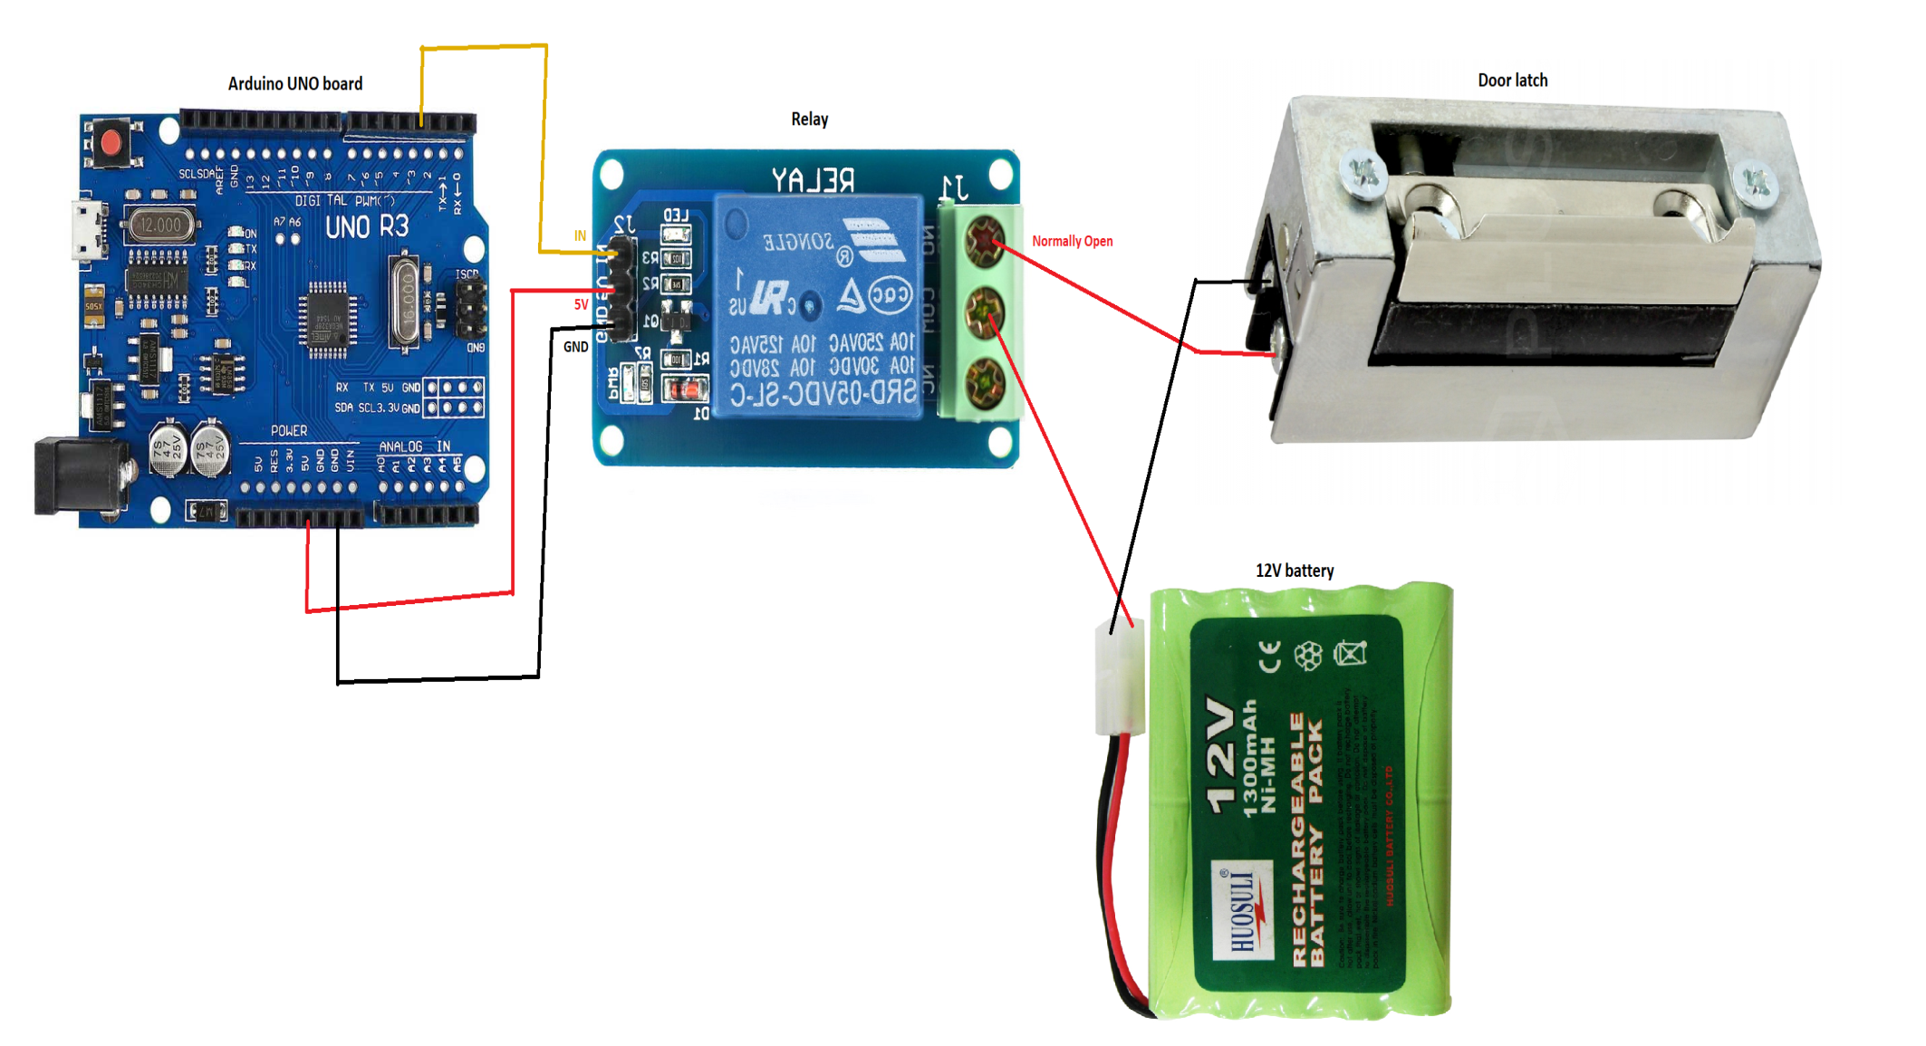
Schematic for door latch and relay

Slide 20
Problems faced
The bluetooth stopped working.
LED stopped working.
The code for the “bluetooth with passcode” doesn’t work
The whole thing doesn’t work sometimes

Slide 21
Gantt chart
Week Task name | 1 |  |  |  |  | 2 |  |  |  |  | 3 |  |  |  |  | 4 |  |  |  |  | 5 |  |  |  |  | 6
Research and familiarising with arduino
Testing arduino with simple codes
Making a simple bluetooth-controlled door
Implementing a passcode to lock and unlock the door
planned
actual

Slide 22
Future implementation
An automatic door unlocker when the bluetooth is in range. May not even be bluetooth could be wifi or zigbee.
-can be disabled in settings
Sensors like fingerprint sensor and facial recognition can be implemented.
An anti-burglar door system which alerts the user/police when someone tries to break/pick the lock.
An app for iphone.

Slide 23
Conclusion
In conclusion, here are the things I learnt:
-Arduino
-making apps
-combining the 2 to work together
-troubleshooting skills
-skills that will let me create many things if I want to

